Slide 1
Addition
Stage 3
RNPS
Week 4
Term 1
Notes:
NSW Syllabus: -MAO-WM-01: develops understanding and fluency in mathematics through exploring and connecting mathematical concepts, choosing and applying mathematical techniques to solve problems, and communicating their thinking and reasoning coherently and clearly.
MA3-AR-01: selects and applies appropriate strategies to solve addition and subtraction problems
Numeracy Progressions:
AdS7: Flexible Strategies with two-digit numbers: identifies that the same combinations and partitions to ten are repeated within each decade (e.g. knowing that 8 + 2 = 10, they know 18 + 2 = 20 and 28 + 2 = 30 etc.)

Slide 2
Learning intention
I can use flexible strategies when adding two digit numbers.
Success Criteria
I know the Friends to 10.
I know the Friends to 20.
I know how to partition numbers.
I know that Friends to 10 partitions are repeated in each decade.

Slide 3
Self Talk
Friends to 10.
Friends to any decade.

Slide 4
Circle Champion
We Do
Notes:
Play Circle Champion with Friends to 10 and Friends to 20.

Slide 5
Friends to 10
You Do
Write the following in your maths book:
Friends to 20
0 + ___ = 10
1 + ___ = 10
2 + ___ = 10
3 + ___ = 10
4 + ___ = 10
5 + ___ = 10
6 + ___ = 10
7 + ___ = 10
8 + ___ = 10
9 + ___ = 10
10 + ___ = 10
0 + ___ = 20
1 + ___ = 20
2 + ___ = 20
3 + ___ = 20
4 + ___ = 20
5 + ___ = 20
6 + ___ = 20
7 + ___ = 20
8 + ___ = 20
9 + ___ = 20
10 + ___ = 20

Slide 6
Friends to 10
You Do
Write the following in your maths book:
Friends to 20
0 + 10 = 10
1 + 9 = 10
2 + 8 = 10
3 + 7 = 10
4 + 6 = 10
5 + 5 = 10
6 + 4 = 10
7 + 3 = 10
8 + 2 = 10
9 + 1 = 10
10 + 0 = 10
0 + 20 = 20
1 + 19 = 20
2 + 18 = 20
3 + 17 = 20
4 + 16 = 20
5 + 15 = 20
6 + 14 = 20
7 + 13 = 20
8 + 12 = 20
9 + 11 = 20
10 + 10 = 20

Slide 7
Partitioning to the Decade
I Do
67 + ___ = 70
34 + ___ = 40
91 + ___ = 100
183 + ___ = 190
1025 + ___ = 1030
Self Talk:
Friends to 10.
Friends to any decade.

Slide 8
Partitioning to the Decade
You Do
Complete the following in your maths book:
Self Talk:
Friends to 10.
Friends to any decade.
a) 64 + ___ = 70
b) 36 + ___ = 40
c) 90 + ___ = 100
d) 182 + ___ = 190
e) 1028 + ___ = 1030
f) 1973 + ___ = 1980
g) 1996 + ___ = 2000
h) 2894 + ___ = 2900
i) 3974 + ___ = 3980
j) 850 304 + ___ = 850 310
k) 729 347 + ___ = 729 350
l) 102 822 + ___ = 102 830
m) 197 408 + ___ = 197 410
n) 199 607 + ___ = 199 610
6 Minutes

Slide 9
Partitioning to the Decade
You Do
a) 64 + 6 = 70
b) 36 + 4 = 40
c) 90 + 10 = 100
d) 182 + 8 = 190
e) 1028 + 2 = 1030
f) 1973 + 7 = 1980
g) 1996 + 4 = 2000
h) 2894 + 6 = 2900
i) 3975 + 5 = 3980
j) 850 304 + 6 = 850 310
k) 729 347 + 3 = 729 350
l) 102 822 + 8 = 102 830
m) 197 408 + 2 = 197 410
n) 199 607 + 3 = 199 610
2 Minutes

Slide 10
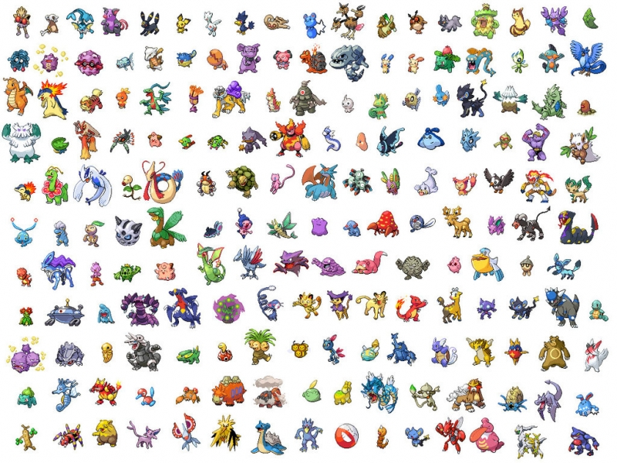
Word Problem
I Do
Khalil had 64 Pokemon cards. Chad gave him 26 more.
How many Pokemon cards does Khalil have in all?
Self Talk:
Friends to 10.
Friends to any decade.
This Photo by Unknown Author is licensed under CC BY

Slide 11
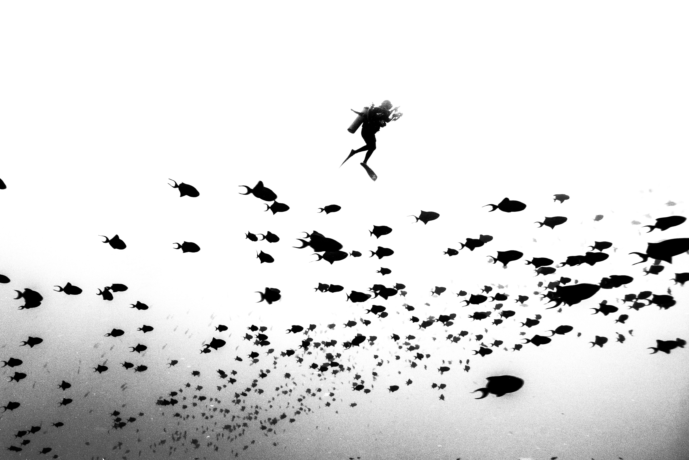
Word Problem
We Do
Samuel counted 91 small fish and 29 larger fish for the school camp feast.
How many fish will there be for the feast?
Self Talk:
Friends to 10.
Friends to any decade.

Slide 12
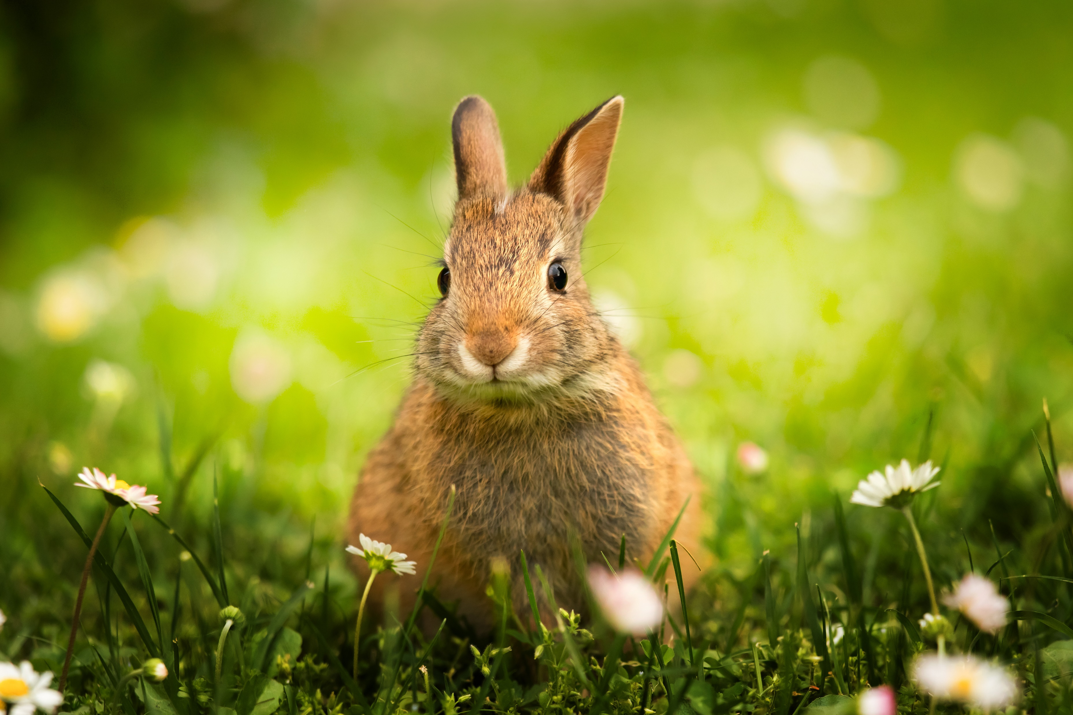
Word Problem
You Do
In her week of camping, Katie saw 105 rabbits run for the safety of their burrows. She also saw 65 rabbits run into the bushes.
How many rabbits did Katie see?
Self Talk:
Friends to 10.
Friends to any decade.

