Slide 1
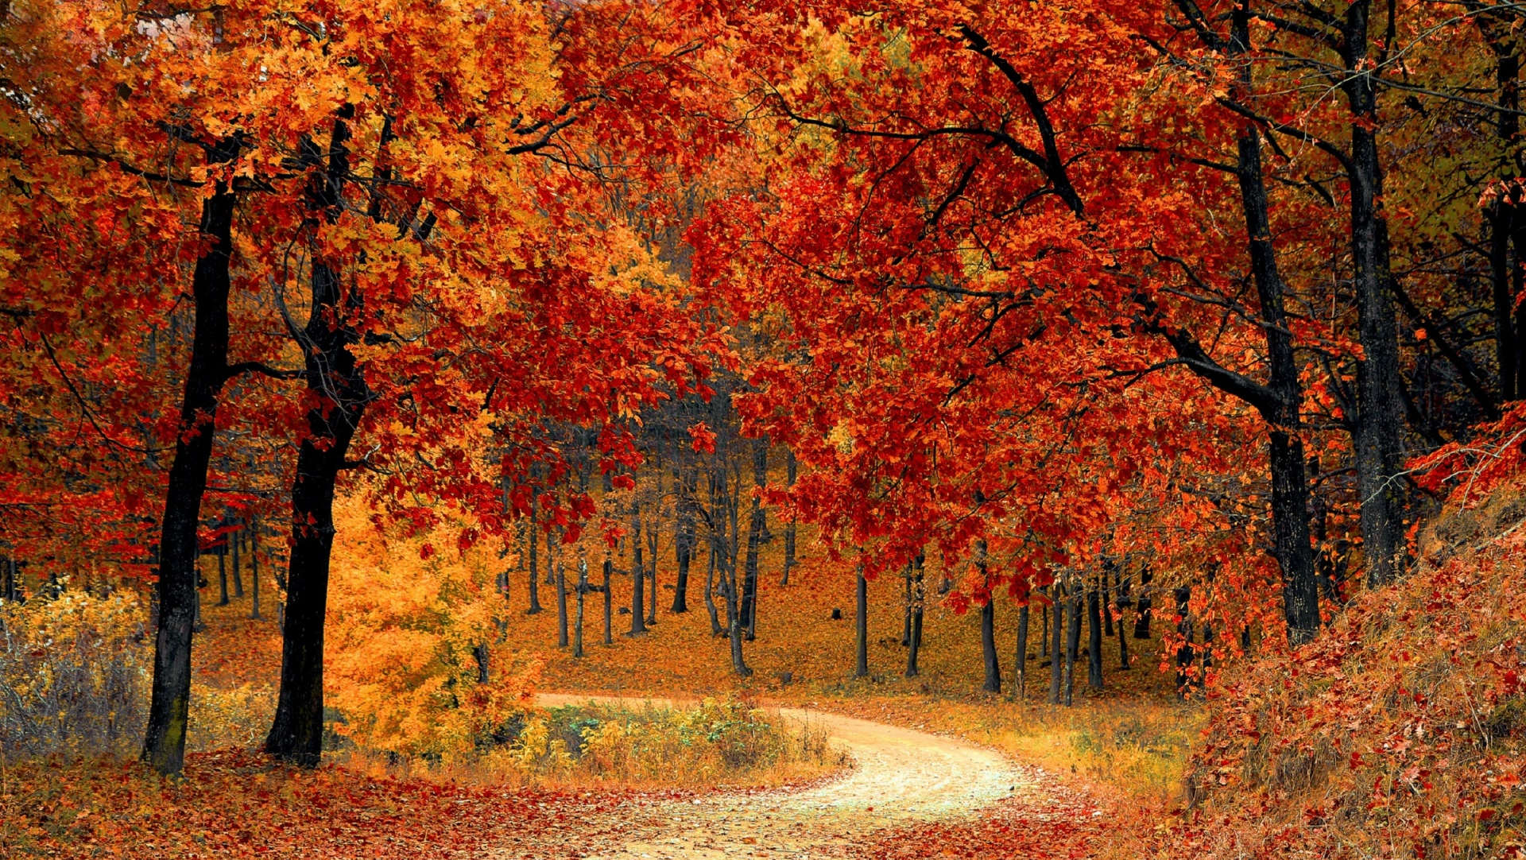
Autumn
RPNS Stage 3 Writing Warm-Up
Building Vocabulary: What, When, Where sentences
Week 10, Term 1
2023

Slide 2
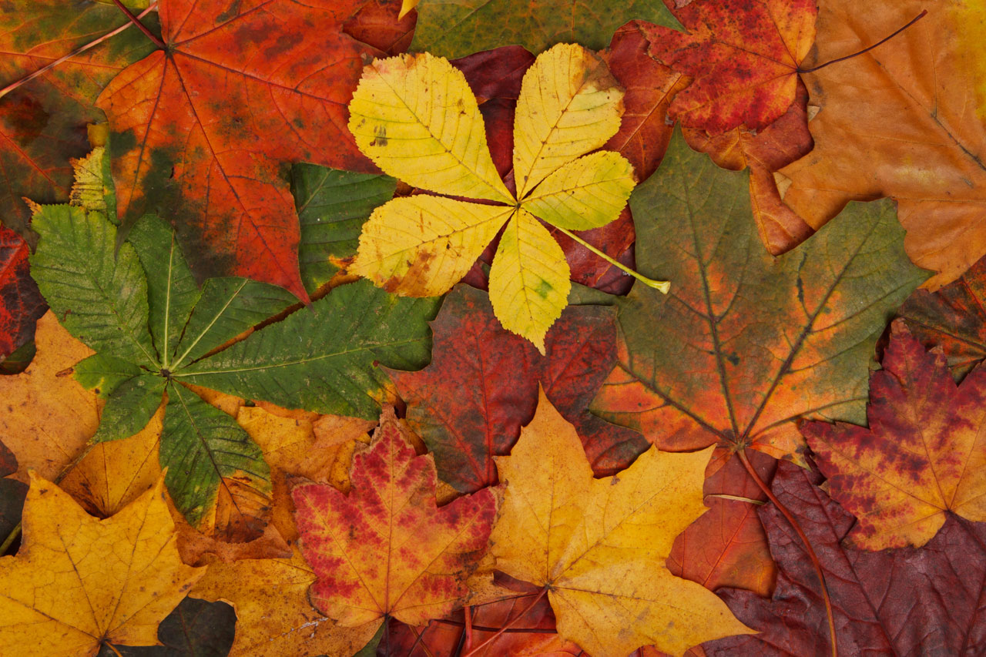
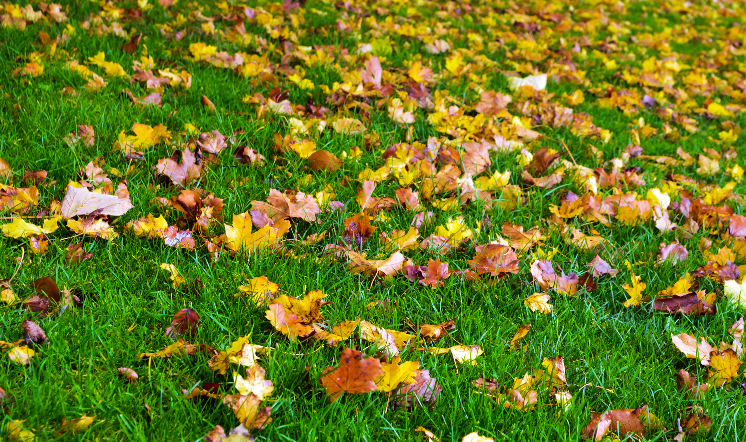
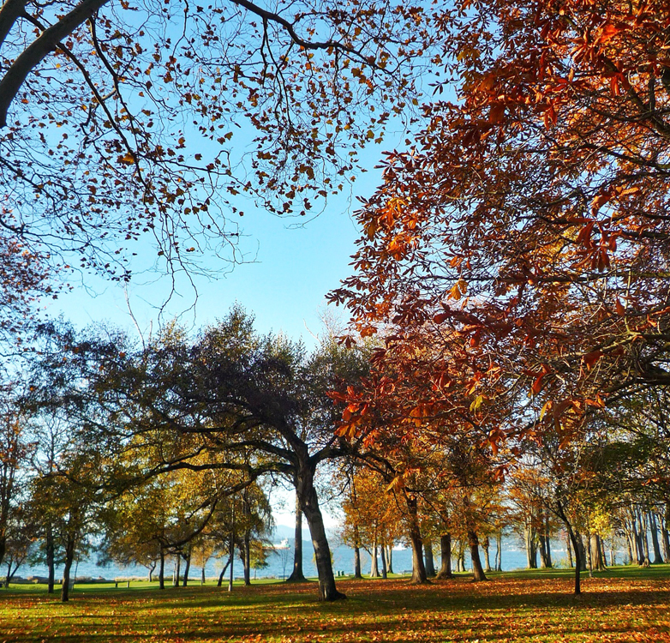
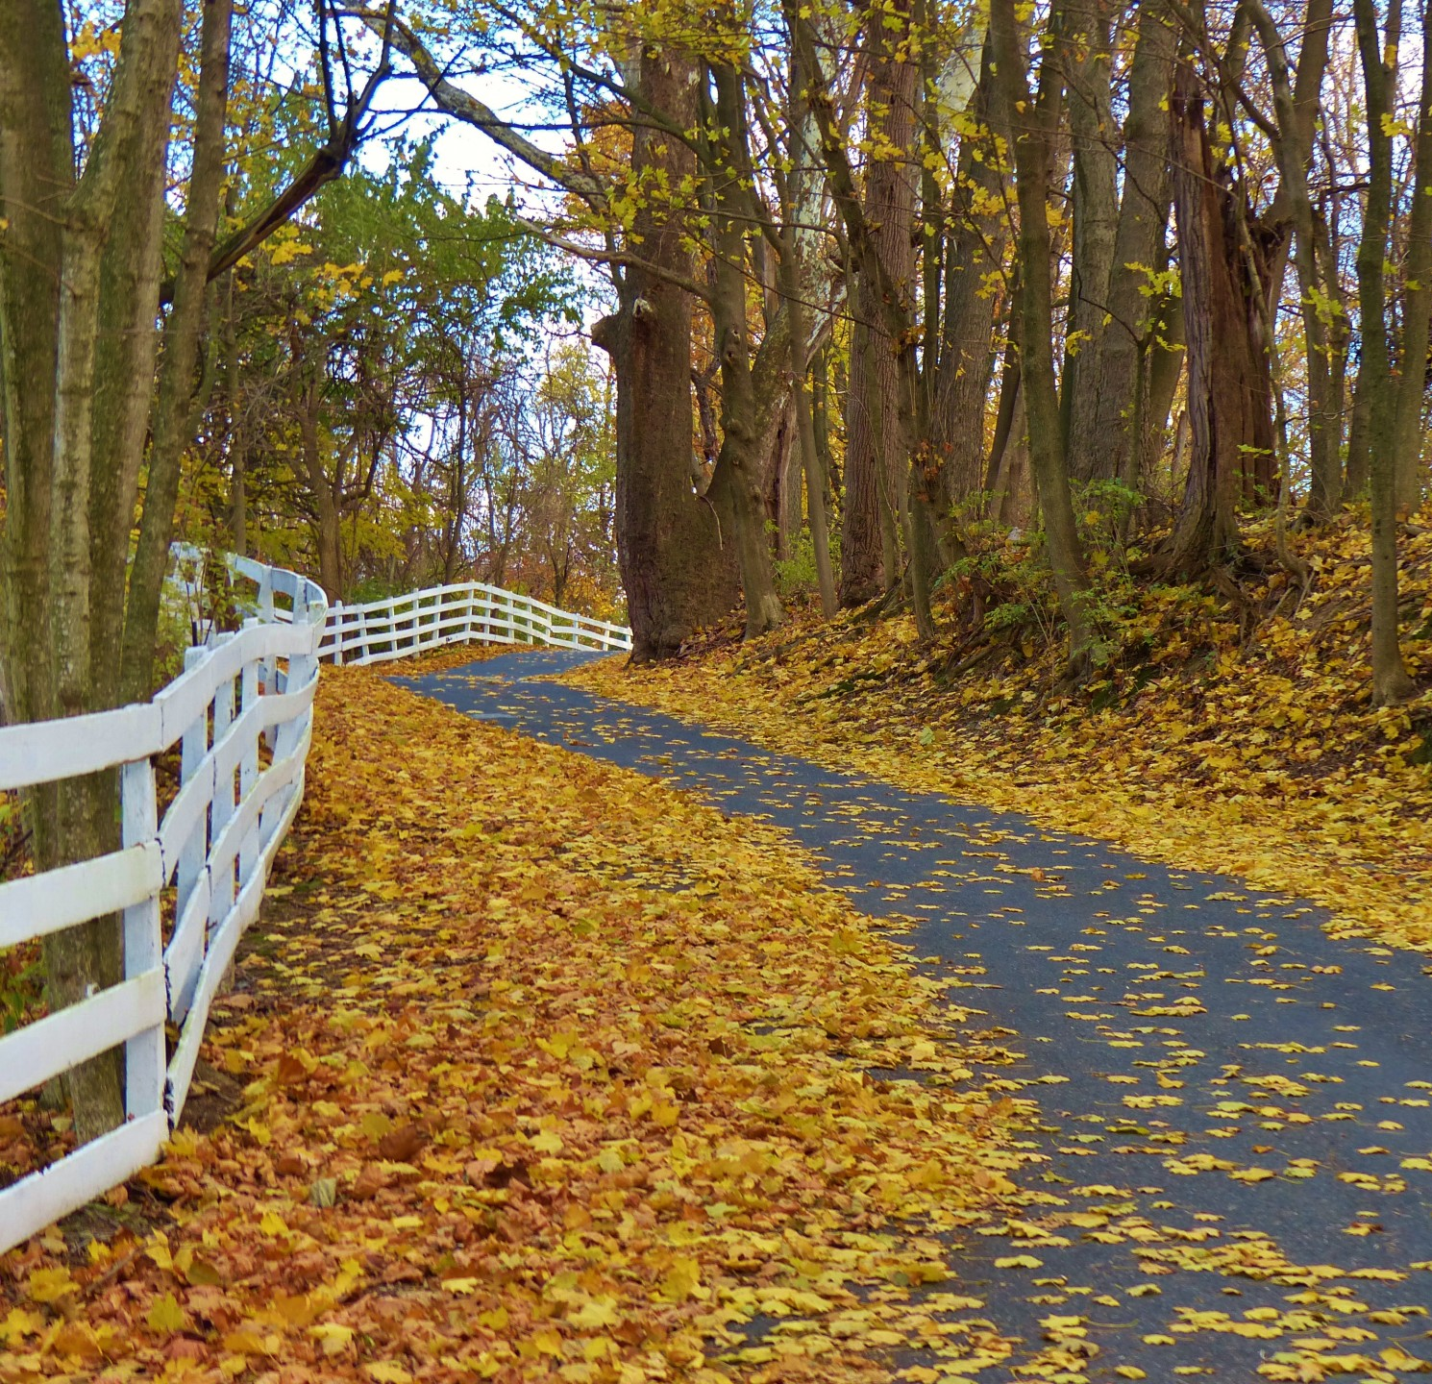
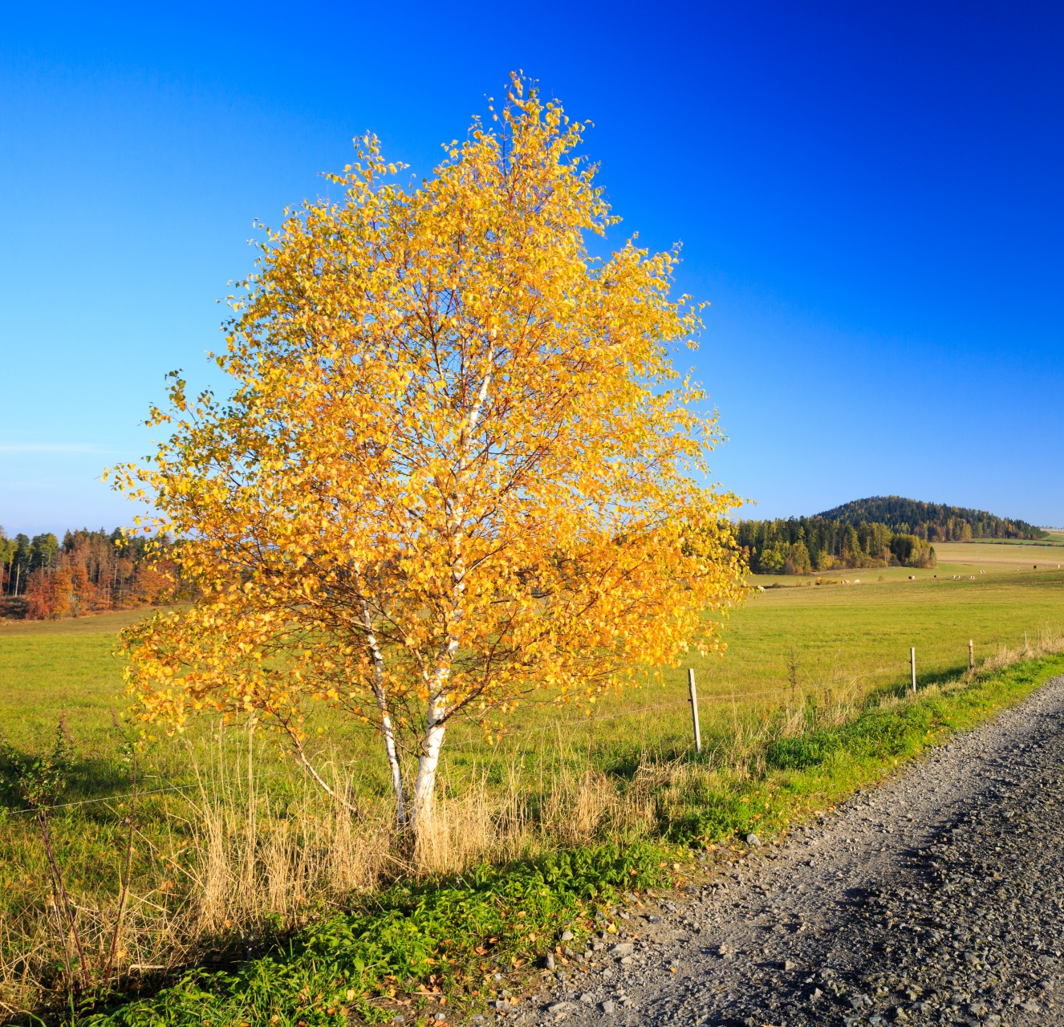
deciduous
abundant
intersperse
susurration
grandeur
russet

Slide 3
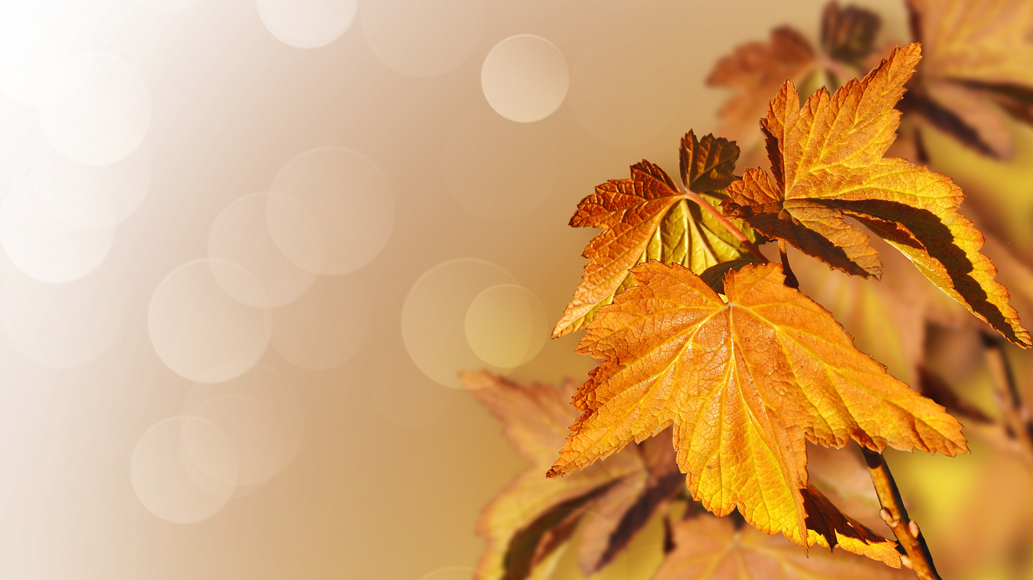
Autumn: Challenge Vocabulary
susurration (noun): whispering or rustling The susurration of the leaves in the park was eery.
russet (noun): reddish-brown colour The fallen leaves had turned a shade of russet.
grandeur (noun): splendour, impressiveness in appearance or style As the tree lost its leaves, the branches stood in a grandeur. intersperse (verb): scatter among or between things The russet leaves had interspersed themselves across the park benches.
deciduous (adjective): shedding its leaves annually The deciduous trees looked as though they had aged gracefully through the season.
abundant (adjective): available in large quantities; plentiful The green leaves were more abundant than the fallen deciduous leaves.

Slide 4
Autumn Brainstorm susurration, russet, grandeur, intersperse, deciduous, abundant
Adjectives​ | Nouns​ | Verbs​
 |  | ​
 |  | Adverbs​

Slide 5
Goal: Add two adjectives and a when
The leaves fell gracefully towards the ground on in the early morning.
The russet, deciduous leaves floated gracefully towards the ground in the crisp, early morning.

Slide 6
Goal: Add two adjectives and a when
Scattered across the ground were an abundance of leaves.
Interspersed across the damp ground were an abundance of flaking leaves from the grandeur trees above.

Slide 7
Goal: Use challenge words to write your own sentence

