Slide 1
English Week 9 – Lesson 1

Slide 2
Learning intentions & Success Criteria
This week we are learning to:
independently read, write and communicate ideas
I can:
use simple and compound sentences when speaking
Participate in small-group and class discussions
segment words into syllables and phonemes as a strategy for spelling
write compound sentences using a coordinating conjunction
find the subject (noun) and verb in a clause
use correct sentence boundary punctuation, such as full stops and capital letters

Slide 3
Daily Review- Short VOWEL sounds
PHONIC KNOWLEDGE
Aa Ee Ii Oo Uu

Slide 4
The /ay/ sound can be represented by be represented by many different graphemes.
ai
as in snail
ay
as in say
a-e
as in bake
Using your finger, ‘write’ the graphemes in the air and on the carpet whilst saying the phoneme aloud.

Slide 5
The /ay/ sound can be represented by be represented by many different graphemes.
ey
as in they
ea
as in break
eigh
as in eight
Using your finger, ‘write’ the graphemes in the air and on the carpet whilst saying the phoneme aloud.

Slide 6
Syllables

Slide 7
Syllables
Syllables are small groups of sounds that you can hear in words. Each syllable must have a vowel sound. We can find out how many syllables are in a word by clapping!

Slide 8
Clap the syllables
a-e | ay | ai | a | ey
plate | strays | tail | baby | hey
crate | play | faint | radio | they
taken | crayon | drain | basic | grey
fake | may | paid | native | prey
concave | lay | wail |  | obey
blade | ray | painting
behave | fray | raining

Slide 9
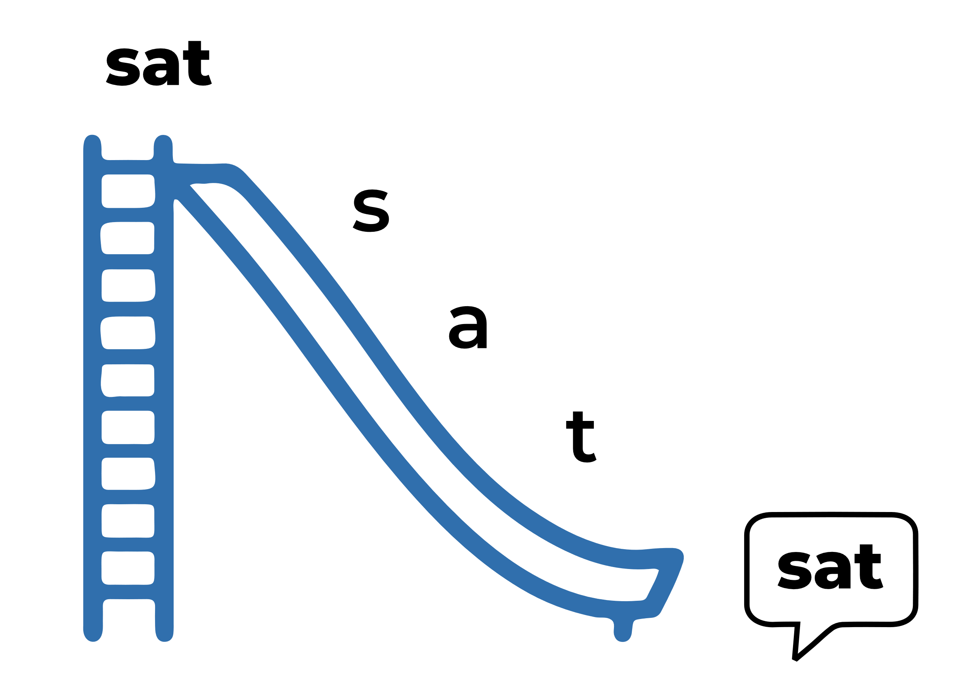
BLENDING SLIDE
When we want to read a word, we: Look at the word Start from the left Blend the letter-sounds together smoothly Listen for the word Say the word

Slide 10
Read the following words.
PHONIC KNOWLEDGE
Blend the phonemes to read the word
pl
ay

Slide 11
Read the following words.
PHONIC KNOWLEDGE
Blend the phonemes to read the word
s
ay

Slide 12
Read the following words.
PHONIC KNOWLEDGE
Blend the phonemes to read the word
ay
d

Slide 13
Read the following words.
PHONIC KNOWLEDGE
Blend the phonemes to read the word
n
m
e
a

Slide 14
Read the following words.
PHONIC KNOWLEDGE
Blend the phonemes to read the word
a
s
m
e

Slide 15
Read the following words.
PHONIC KNOWLEDGE
Blend the phonemes to read the word
eight

Slide 16
Read the following words.
PHONIC KNOWLEDGE
Blend the phonemes to read the word
sleigh

Slide 17
High Frequency Word
Read the following words.
a

Slide 18
High Frequency Word
Read the following words.
be

Slide 19
High Frequency Word
Read the following words.
in

Slide 20
High Frequency Word
Read the following words.
that

Slide 21
High Frequency Word
Read the following words.
you

Slide 22
High Frequency Word
Read the following words.
was

Slide 23
High Frequency Word
Read the following words.
and

Slide 24
High Frequency Word
Read the following words.
to

Slide 25
High Frequency Word
Read the following words.
of

Slide 26
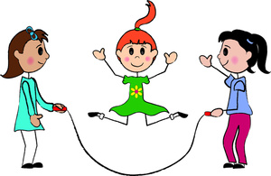
SENTENCE Writing
Oral Language
Creating written texts
What is a verb?
A verb is a word that shows an action, occurrence, or state of being.
Every sentence must have a verb.

Slide 27
Some examples of Verbs
is | am | are | were
was | has | have | had
hate | wish | like | want
ask | shout | scream | whisper
cry | fly | play | jump

Slide 28
Oral Language
Let’s write a sentence using the verb, ‘like’
Creating written texts
Remember, you can::
Copy the sentence
Change the sentence
Create your own sentence classroom.

Slide 29
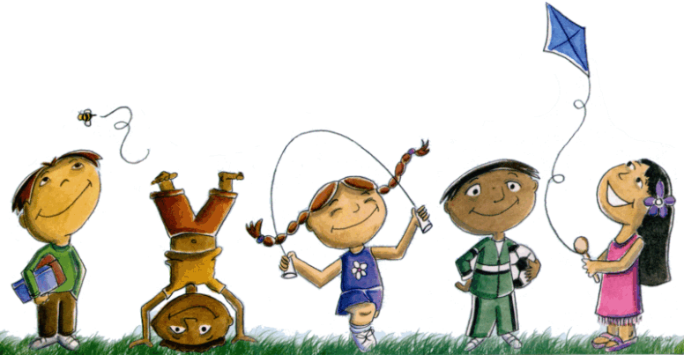
Oral Language
Let’s write a sentence using the verb, ‘like’
Creating written texts
I like to play.d back to our classroom.
Copy
Change
Create

Slide 30
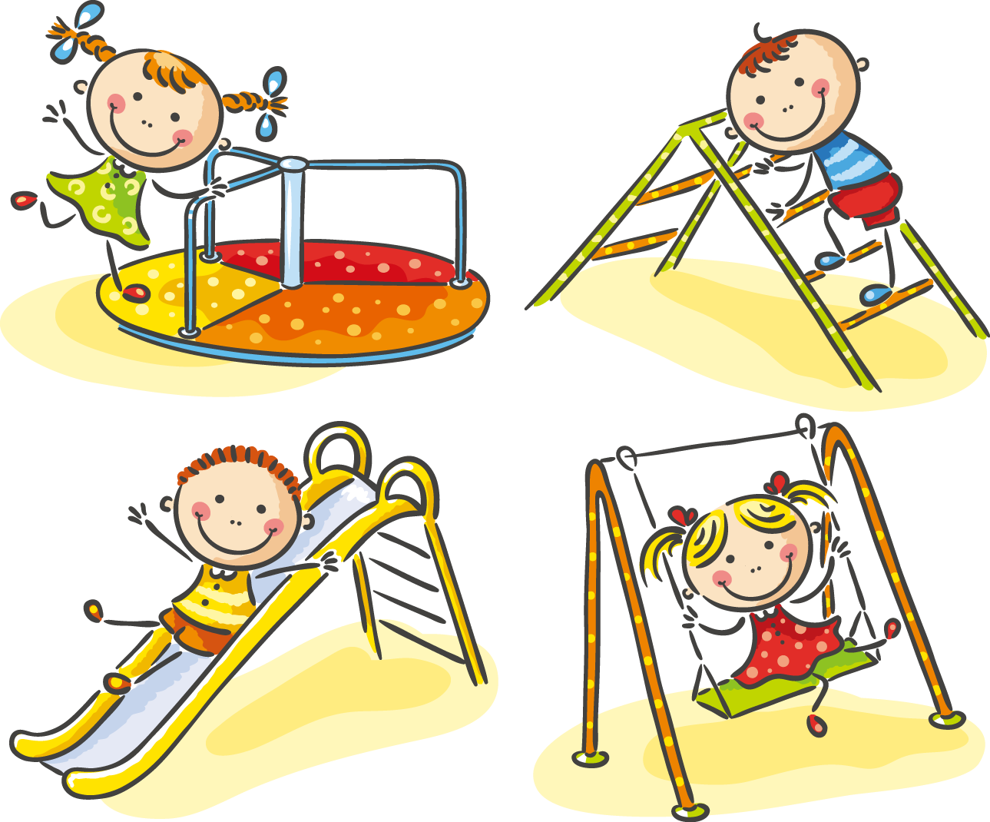
Oral Language
Let’s write a sentence using the verb, ‘like’
Creating written texts
Copy
Change
Create
I like to play at the park. we lined up at the desk to borrow our book. Finally, we walked back to our classroom.

Slide 31
Oral Language
Let’s write a sentence using the verb, ‘like’
Creating written texts
On Friday, I like to play at the park. Finally, we walked back to our classroom.
Copy
Change
Create

Slide 32
Lesson 2

Slide 33
Learning intentions & Success Criteria
This week we are learning to:
independently read, write and communicate ideas
I can:
use simple and compound sentences when speaking
Participate in small-group and class discussions
segment words into syllables and phonemes as a strategy for spelling
write compound sentences using a coordinating conjunction
find the subject (noun) and verb in a clause
use correct sentence boundary punctuation, such as full stops and capital letters

Slide 34
Daily Review
PHONIC KNOWLEDGE
pl
br
fl
pr
cl
sl
cr
gr
sp
sm
sn
st
sw
tw
sk
qu

Slide 35
The /ay/ sound can be represented by be represented by many different graphemes.
ey
as in they
ea
as in break
eigh
as in eight
Using your finger, ‘write’ the graphemes in the air and on the carpet whilst saying the phoneme aloud.

Slide 36
PHONIC KNOWLEDGE
Say the word
grey
Segment the word
Write the word
Check the word

Slide 37
PHONIC KNOWLEDGE
Say the word
they
Segment the word
Write the word
Check the word

Slide 38
PHONIC KNOWLEDGE
Say the word
steak
Segment the word
Write the word
Check the word

Slide 39
SPELLING
Say the word
break
Segment the word
Write the word
Check the word

Slide 40
SPELLING
Say the word
great
Segment the word
Write the word
Check the word

Slide 41
SPELLING
Say the word
eight
Segment the word
Write the word
Check the word

Slide 42
PHONIC KNOWLEDGE
Say the word
eighty
Segment the word
Write the word
Check the word

Slide 43
SPELLING
Say the word
weight
Segment the word
Write the word
Check the word

Slide 44
High Frequency Word
Use your mini white board to write these HFW words
Say the HFW
and
Write the HFW word
Check the word

Slide 45
High Frequency Word
Use your mini white board to write these HFW words
Say the HFW
can
Write the HFW word
Check the word
Repat 5 times

Slide 46
High Frequency Word
Use your mini white board to write these HFW words
Say the HFW
of
Write the HFW word
Check the word
Repat 5 times

Slide 47
SENTENCE Writing
Oral Language
Creating written texts
Types of Verbs
Types of Verbs | Definition | Examples
Action verbs | What we do | jump, play, read
Saying verbs | What we say | whisper, ask, shout, say
Sensing verbs | What we think and feel | see, look, smell, listen
Relating verbs | How we make links between bits of information | is, has, have, had, be, are

Slide 48
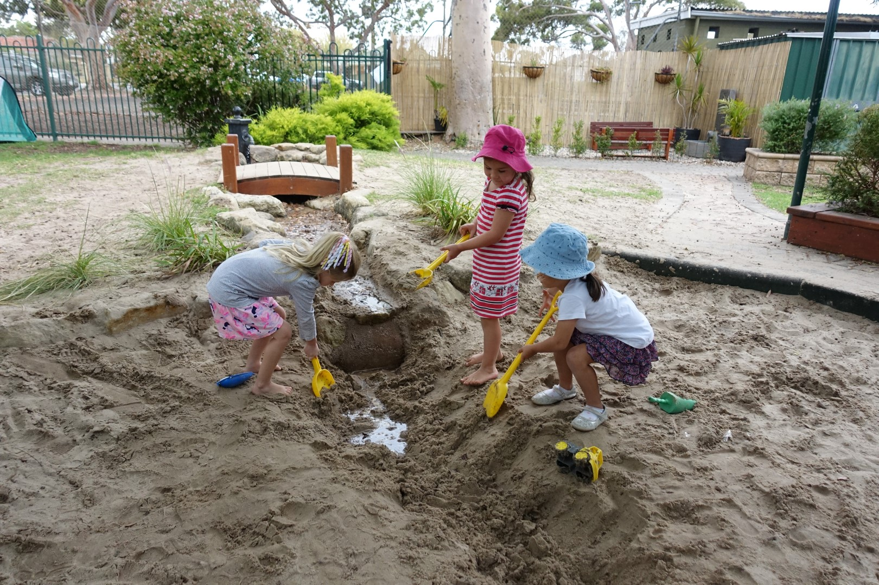
ORAL LANGUAGE
Let’s write a sentence with an action verb.
WRITTEN TEXTS
I play in the sandpit.
Copy
Change
Create

Slide 49
ORAL LANGUAGE
Let’s write a sentence with a saying verb.
WRITTEN TEXTS
Copy
Change
Create
I asked for a new toy.

Slide 50
ORAL LANGUAGE
Let’s write a sentence with a sensing verb.
WRITTEN TEXTS
Copy
Change
Create
I can smell the flowers.!’.

Slide 51
ORAL LANGUAGE
Let’s write a sentence with a relating verb.
WRITTEN TEXTS
Copy
Change
Create
She has a new pencil case.

Slide 52
Lesson 3 and 4- Sentence Writing over 2 days. Review phonics daily

Slide 53
Learning intentions & Success Criteria
This week we are learning to:
independently read, write and communicate ideas
I can:
use simple and compound sentences when speaking
Participate in small-group and class discussions
segment words into syllables and phonemes as a strategy for spelling
write compound sentences using a coordinating conjunction
find the subject (noun) and verb in a clause
use correct sentence boundary punctuation, such as full stops and capital letters

Slide 54
Daily Review
PHONIC KNOWLEDGE
a
e
i
o
u
b
bb
c
k
ck
qu
d
dd
th
sh
ch
wh

Slide 55
The /ay/ sound can be represented by be represented by many different graphemes.
ey
as in they
ea
as in break
eigh
as in eight
Using your finger, ‘write’ the graphemes in the air and on the carpet whilst saying the phoneme aloud.

Slide 56
Clap the Syllables
a-e | ay | ai | a | ey | ea | eigh
plate | stray | tail | baby | they | great | eight
crate | play | faint | radio | grey | break | eighteen
taken | crayon | drain | basic | prey | steak | sleigh
fake | may | paid | native | obey | greater | weigh
concave | lay | wail |  |  | daybreak | weight
blade | ray | painting |  |  | breaking | freight
behave | fray | raining |  |  | breaker | neighing

Slide 57
Oral Language
Let’s blend sounds to make words.
Creating written texts
Hmm, I think our teacher got a bit confused! Some of the words below are not quite right. Can you blend the sounds (phonemes) together to make a word and let your teacher know which ones are silly words? .

Slide 58
PHONIC KNOWLEDGE
Say the word
obey
Segment the word
Write the word
Check the word

Slide 59
PHONIC KNOWLEDGE
sape
Say the word
Segment the word
Write the word
Check the word

Slide 60
PHONIC KNOWLEDGE
thay
Say the word
Segment the word
Write the word
Check the word

Slide 61
PHONIC KNOWLEDGE
Say the word
they
Segment the word
Write the word
Check the word

Slide 62
PHONIC KNOWLEDGE
Say the word
steak
Segment the word
Write the word
Check the word

Slide 63
SPELLING
Say the word
bweak
Segment the word
Write the word
Check the word

Slide 64
SPELLING
Say the word
great
Segment the word
Write the word
Check the word

Slide 65
SPELLING
Say the word
eight
Segment the word
Write the word
Check the word

Slide 66
PHONIC KNOWLEDGE
Say the word
eightly
Segment the word
Write the word
Check the word

Slide 67
SPELLING
Say the word
eighteen
Segment the word
Write the word
Check the word

Slide 68
High Frequency Word
Use your mini white board to write these HFW words
Say the HFW
was
Write the HFW word
Check the word

Slide 69
High Frequency Word
Use your mini white board to write these HFW words
Say the HFW
like
Write the HFW word
Check the word
Repat 5 times

Slide 70
High Frequency Word
Use your mini white board to write these HFW words
Say the HFW
if
Write the HFW word
Check the word
Repat 5 times

Slide 71
SENTENCE Writing
Oral Language
Creating written texts
Conjunctions
Coordinating conjunctions can be used to combine 2 simple sentences into one compound sentence.
F | A | N | B | O | Y | S
for | and | nor | but | or | yet | so

Slide 72
Oral Language
Let’s write sentences using coordinating conjunctions
Creating written texts
Remember, you can::
Copy the sentence
Change the sentence
Create your own sentence or paragraphm.

Slide 73
ORAL LANGUAGE
Let’s write a compound sentence using the coordinating conjunction and.
WRITTEN TEXTS
I play in the sandpit and I dig big holes.
Copy
Change
Create

Slide 74
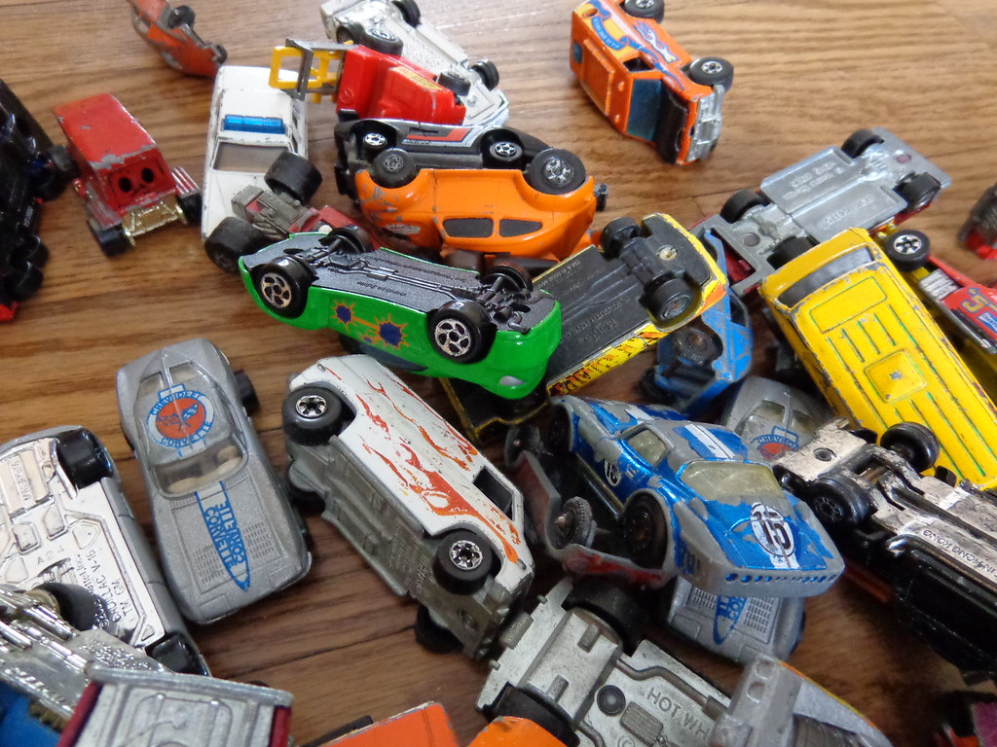
ORAL LANGUAGE
Let’s write a compound sentence using the coordinating conjunction but.
WRITTEN TEXTS
Copy
Change
Create
I asked for a new truck but I got a toy car.
This Photo by Unknown Author is licensed under CC BY

Slide 75
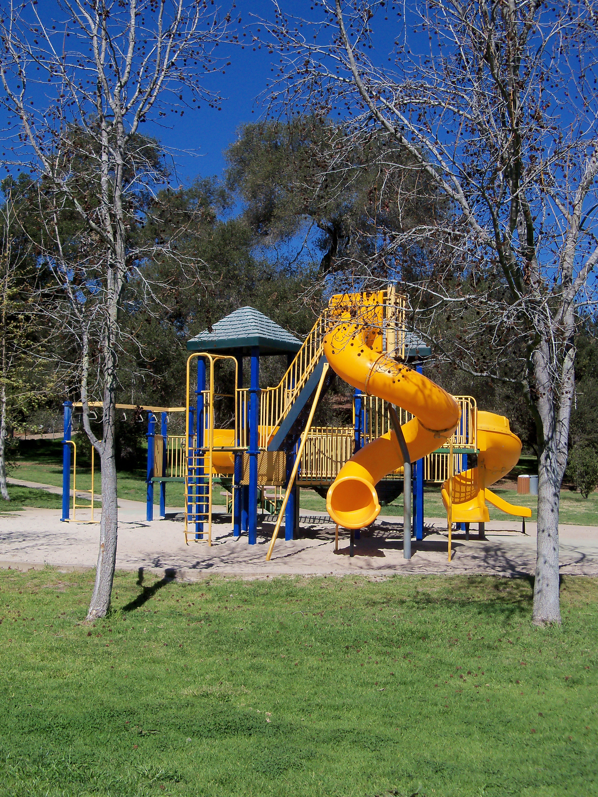
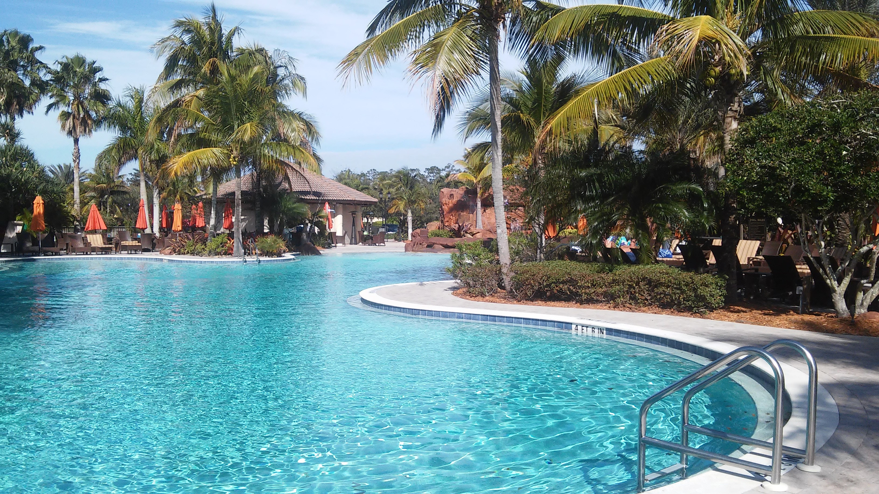
ORAL LANGUAGE
Let’s write a compound sentence using the coordinating conjunction or.
WRITTEN TEXTS
Copy
Change
Create
I can go to the park or I can go to the pool.

Slide 76
ORAL LANGUAGE
Let’s write a compound sentence using the coordinating conjunction and.
WRITTEN TEXTS
Copy
Change
Create
She got a new pencil case yet it was broken.

Slide 77
Oral Language
We have made sentences using coordinating conjunctions
Creating written texts
Can you::
Find the verbs? Circle them
Find the nouns? Underline them
Check you used punctuation?.

Slide 78
Lesson 5- Use previous phonics review from lesson 1-4.

Slide 79
Oral Language
Let’s write sentences using coordinating conjunctions
Creating written texts
Remember, you can::
Copy the sentence
Change the sentence
Create your own sentence or paragraphm.

Slide 80
Oral Language
Let’s write sentences using coordinating conjunctions
Creating written texts
I like running but I do not like skipping.
She likes apples and she likes bananas.
He likes Lego yet he hates toy cars.
.

Slide 81
Oral Language
Let’s write sentences using coordinating conjunctions
Creating written texts
Challenge Time:
Let’s add to our sentences using when, who and where.
On Sunday, Jane went to the park and she went to McDonalds.
.

Slide 82
Oral Language
Let’s write sentences using coordinating conjunctions
Creating written texts
Challenge Time:
Let’s add to our sentences using words showing when.
On Sunday,
This weekend,
Last night,

Slide 83
Oral Language
Let’s write sentences using coordinating conjunctions
Creating written texts
Challenge Time:
Let’s add to our sentences using words saying who.
I
Jane
my family

Slide 84
Oral Language
Let’s write sentences using coordinating conjunctions
Creating written texts
Challenge Time:
Let’s add to our sentences using words saying where.
went to the park
flew to Japan
ate dinner at KFC

