Slide 1
RNPS Parent reading Workshop New Curriculum
Friday 28th April
2023

Slide 2
Acknowledgement of Country
Notes:
Acknowledgement of Country

Slide 3
In this workshop we will cover:
The new curriculum for English, specifically reading
How reading is being taught at RNPS
What books are we using for reading
Ways to support your child at home
Notes:
Read from slide

Slide 4
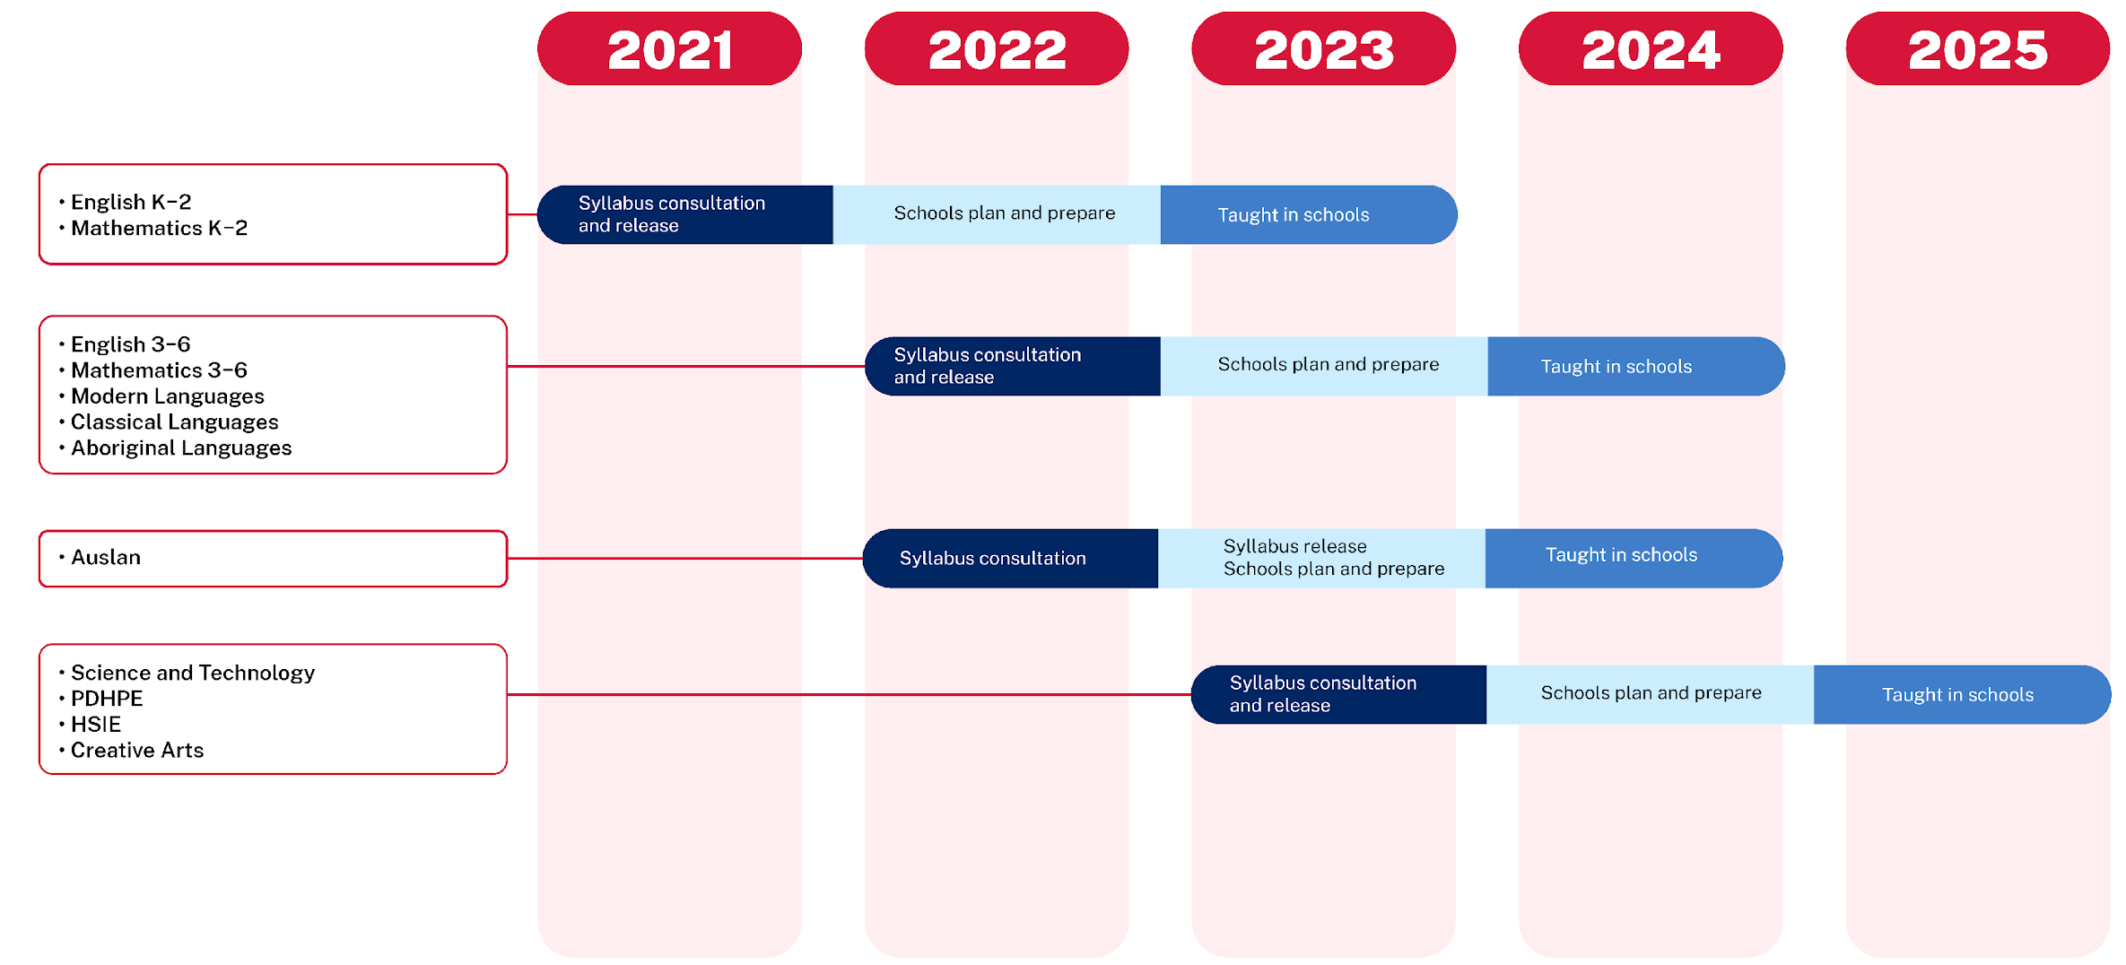
NESA syllabus timeline
Primary – Kindergarten to Year 6
Notes:
Last year new Curriculum were introduced in NSW for English and Mathematics.
Slide showing timeline of curriculum and explain.

Slide 5
English K-2
Notes:
Explain new English content

Slide 6
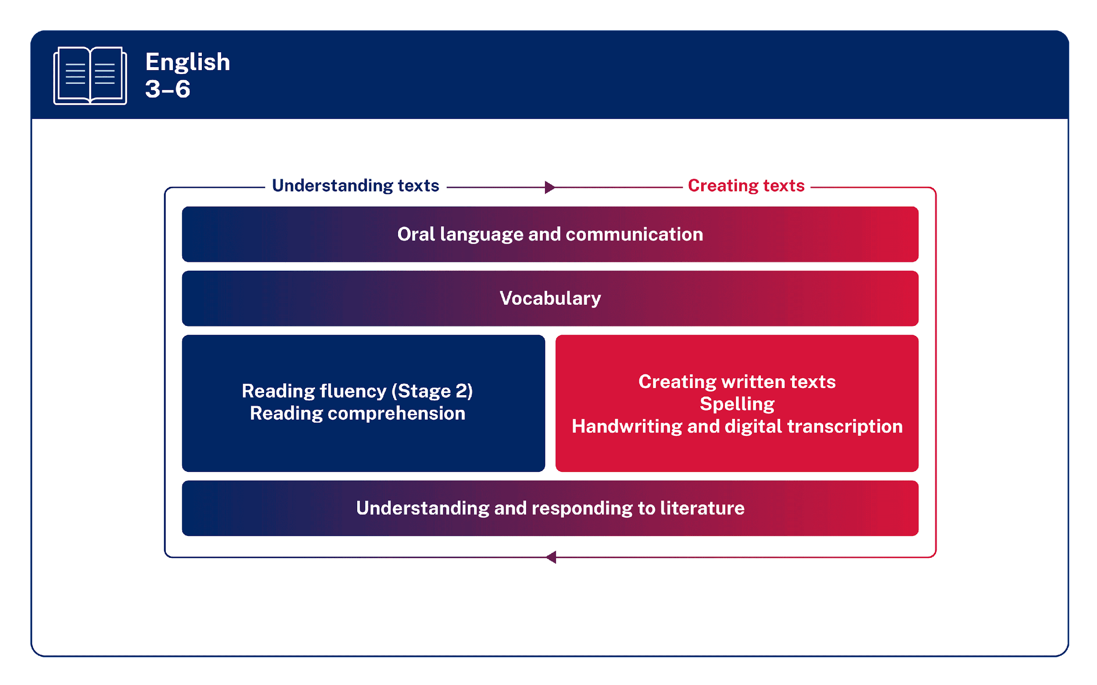
English 3-6
Notes:
Explain new English content for 3-6.

Slide 7
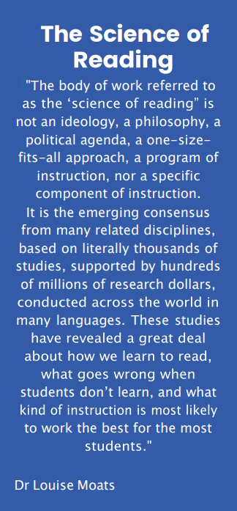
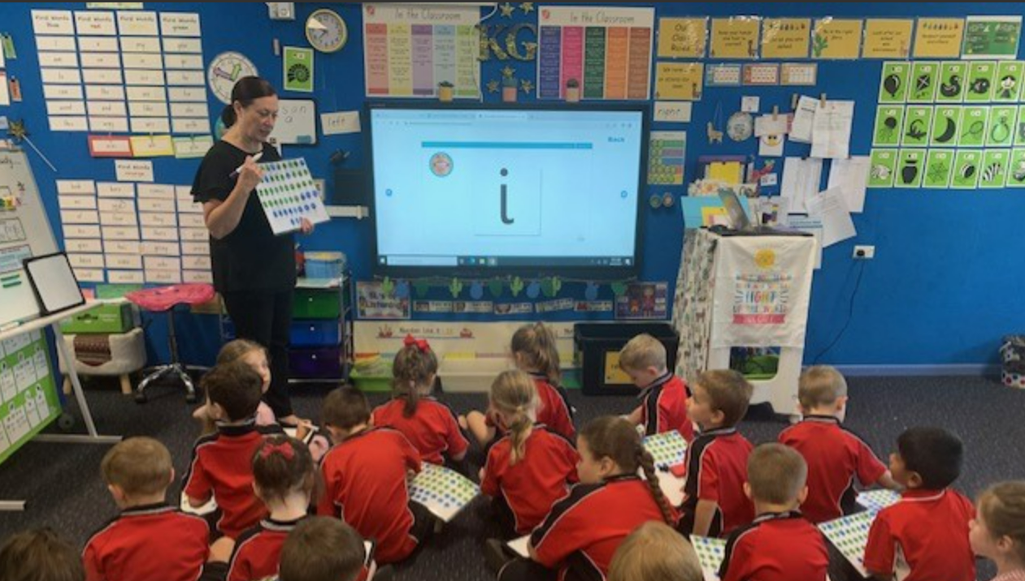
Louisa Moats
Notes:
Over the last several decades there have been many studies conducted into how children learn to read. This research has produced a body of knowledge known as the Science of Reading. The new English curriculum incorporates the Science of Reading. What is the Science of Reading?

Slide 8
The Science of Reading
Notes:
One diagram represents the basis of these findings.
Reading Rope
All of these are important components.
What’s new about this? Systematic explicit phonics instruction.

Slide 9
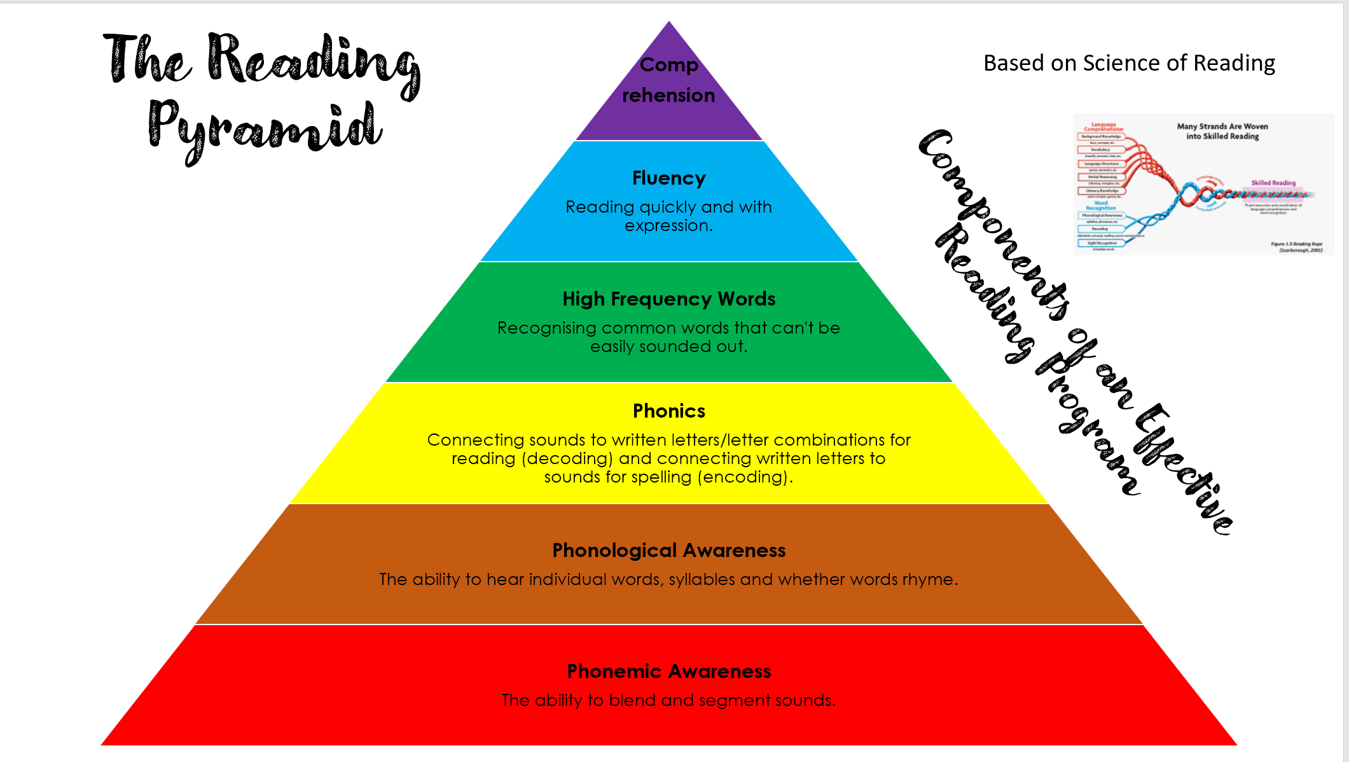
Notes:
This is framework we adopted at RNPS in Stage 1 in 2022 and now being implemented throughout the school where applicable to build key on skills for all learners. Students who are yet to master the alphabetic code will have difficulties at the top of the pyramid as so much cognitive load is spent at the decoding level.

Slide 10
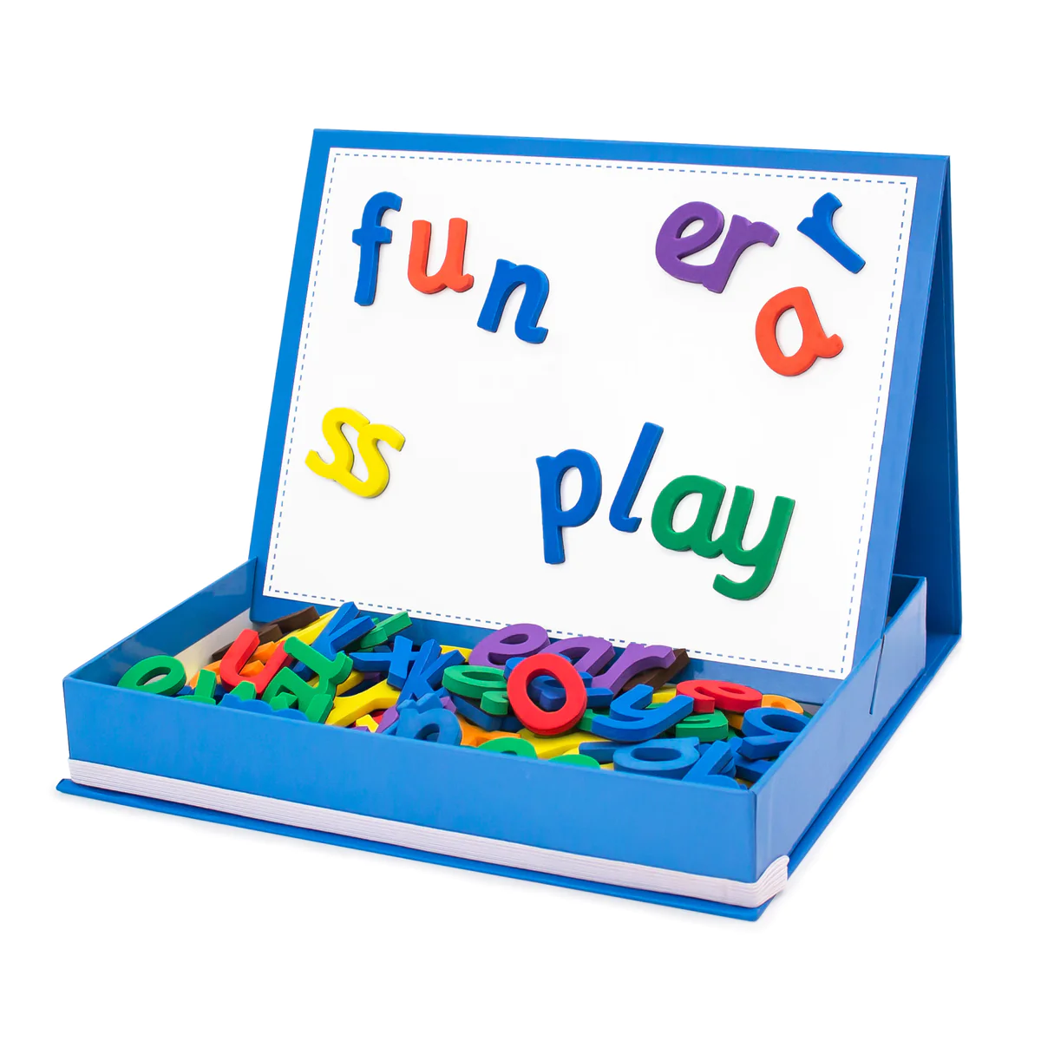
What is Phonics?
Phonics is the understanding that there is a predictable relationship between phonemes (the sounds of spoken language) and graphemes (the letters that represent them in written language).
The ability to use phonetic skills is an essential component of reading and writing.
Notes:
Phonics is the code that English is written in and that letters represent sounds.
Phonics is not just about learning the code. It’s also about the skill of blending the sounds together to read the words.

Slide 11
Words to know
Phoneme
Smallest unit of sound (‘phone’) – what you hear
Grapheme
The letters we use to represent the sounds/phonemes
Notes:
Research suggests that students should be taught this language when referring to the sounds and letters of words. They may come home and use these terms when completing spelling tasks or home reading.
Phoneme
Sound (‘phone’) – what you hear
The smallest units of sound
There are 44 phonemes in English
E.g.
Sat – s a t – 3 phonemes
Grapheme
The letters we use to represent the sounds/phonemes
Graph (what you see)
E.g. the letter m is a grapheme. It represents the phoneme /m/ at the beginning of the word “mat”.
In English there are sometimes several ways to write one sound
E.g. the /long a/ sound can be written as:
ai, ay, a_e, a etc.

Slide 12
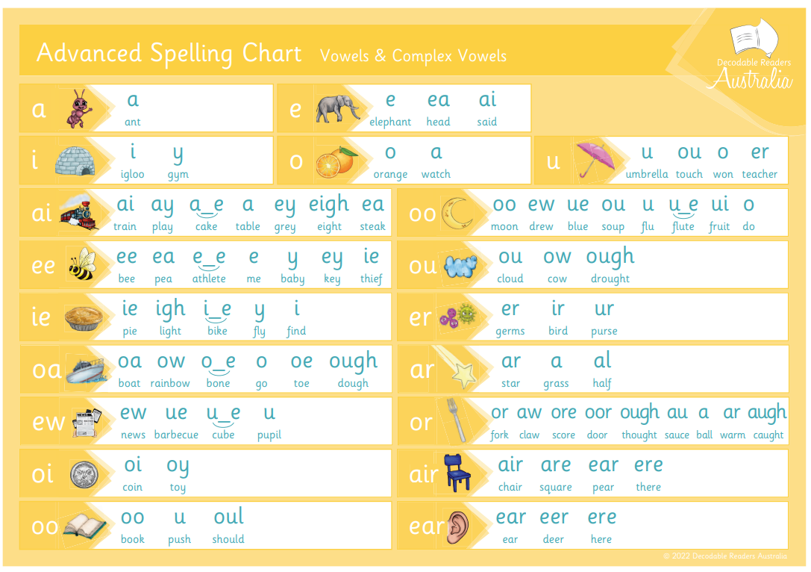
44 phonemes in English (Vowels)
Notes:
There are 44 sounds (phonemes) in English and these are written with combinations of the 26 letters (graphemes). (DRA is the books used in kindergarten and some others)

Slide 13
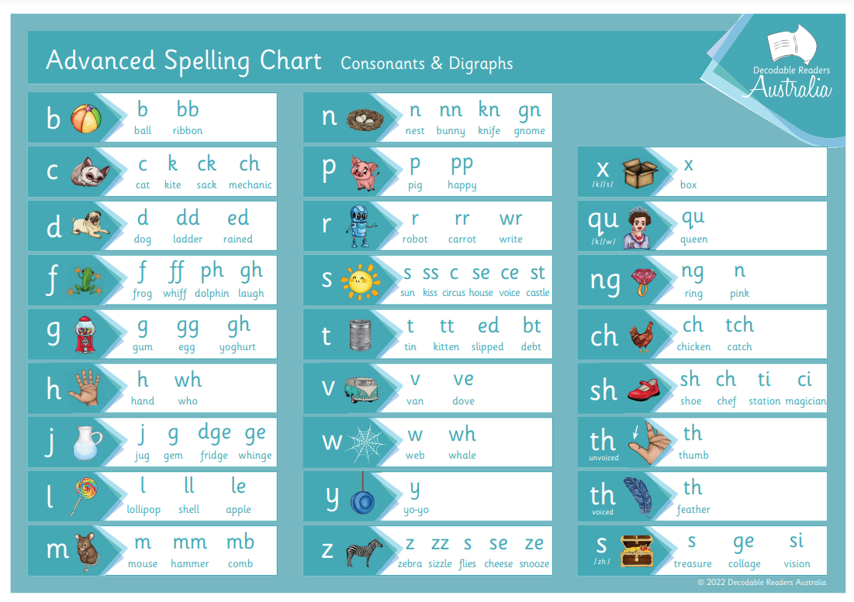
44 phonemes in English (Consonants)
Notes:
There are 44 sounds (phonemes) in English and these are written with combinations of the 26 letters (graphemes).

Slide 14
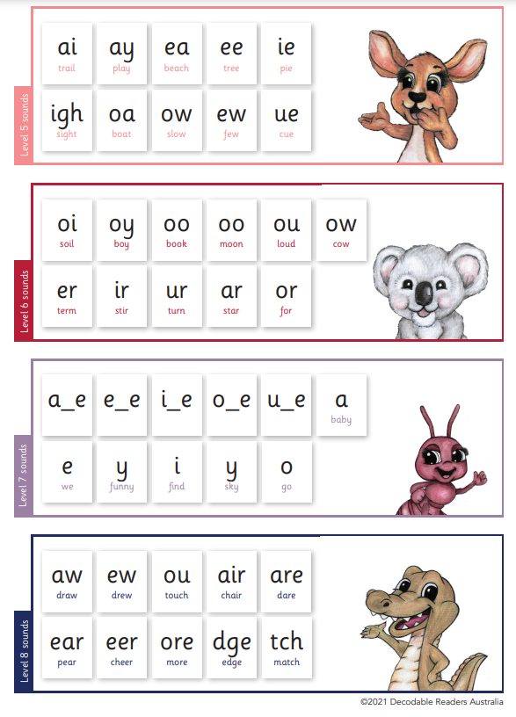
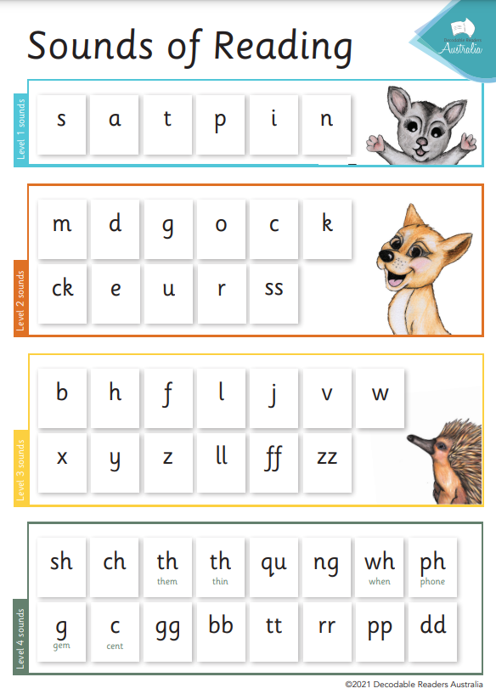
Phonics sequence- basic code in Kinder, continued 1-6
Notes:
Basic code is taught in Kindy. Then the more complex code is taught in Year 1 and 2, and revised in Years 3-6 until all students have understood it.

Slide 15
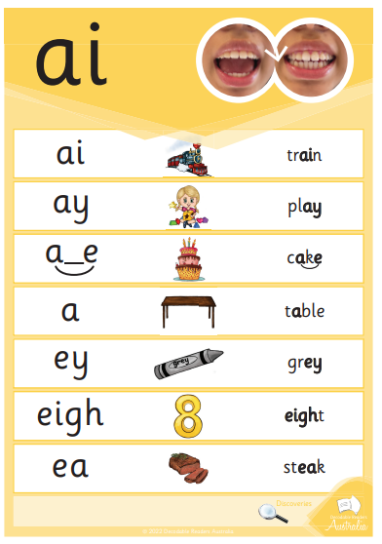
These are all the graphemes that represent the long a phoneme
ai is used at the beginning or middle of a word, like aid
ay is used at the end of a word, like today
The split digraph, a_e needs one consonant
Notes:
This is an example of one sound (phoneme) being represented many ways.
Explain that the long a sound can be represented with many graphemes. There are some rules for which graphemes are used in which positions in words. E.g ay is used at the end of a base word, and ai is used in the beginning or middle.

Slide 16
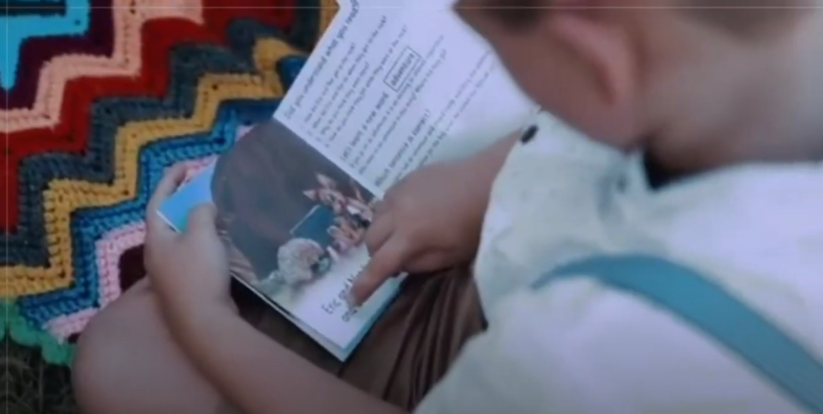
Blending
https://www.youtube.com/watch?v=ev_xyxTnE_M
Notes:
Phonics is not just about learning the code. It’s also about the skill of blending the sounds together to read the words.
Play video from DRA- Series 2, Episode 1.
https://www.decodablereadersaustralia.com.au/pages/sor-learning-lounge-series-2
Stop at 3:45 for press and roll, pop and slide, word sliders and drive and park.
Press and roll: play dough
Pop and slide: poppers
Word sliders: folded paper
Drive and park: car
Beads, ball

Slide 17
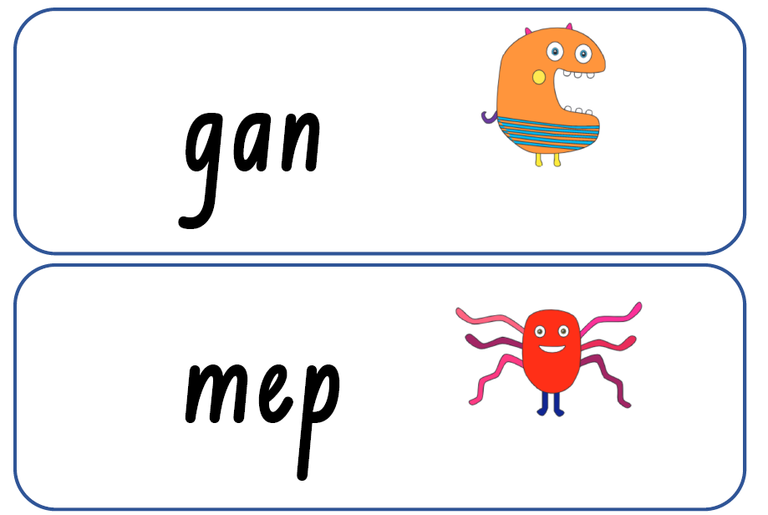
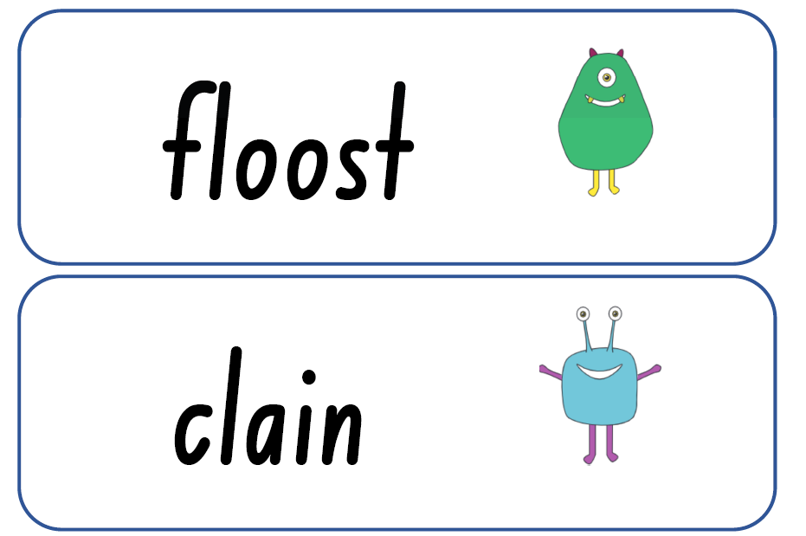
Blending practice ‘It’s your turn!’
Notes:
Parents read these words by blending. (from DoE Phonics Diagnostic assessment)

Slide 18
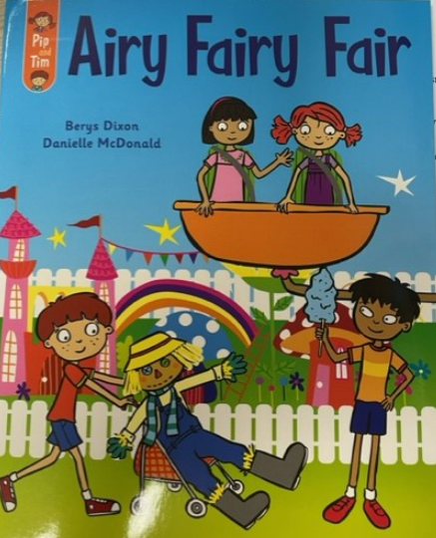
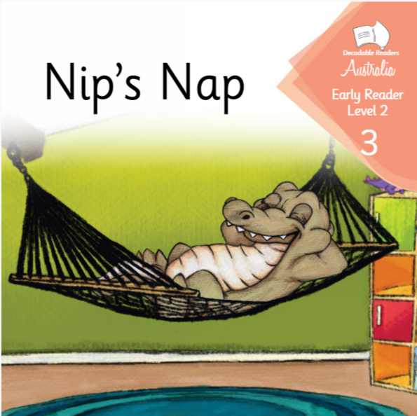
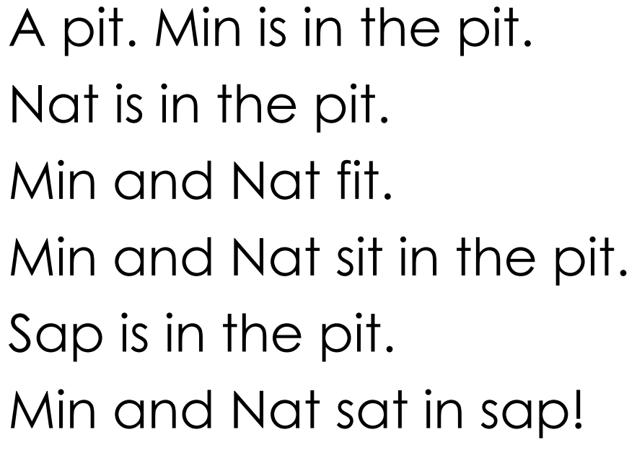
Decodable Texts
Little Learners Love Literacy is used in Stage 1 (Years 1 and 2)
Notes:
Decodable texts -
Are texts where the words are matched to the sounds that the students have learned so far.
Students can work out all the words by blending (decoding).
Students move through the sequence of decodables according to the sounds that they have learnt.
Look at the examples on the table.
We still focus on meaning, but the students work out the words first and then check by asking if that made sense.
Students can read words even if there are not pictures with the text.

Slide 19
Decodable Texts
Notes:
Decodables use controlled text.
This means there is a sequential introduction of letters and sounds beginning from the basic phonics code that includes single sounds such as s, a, t, p, i, n. The books move on in complexity of letters and sounds.
Show parents the book above.
Discuss:
The sounds featured in this book.
Look at the words within the book.

Slide 20
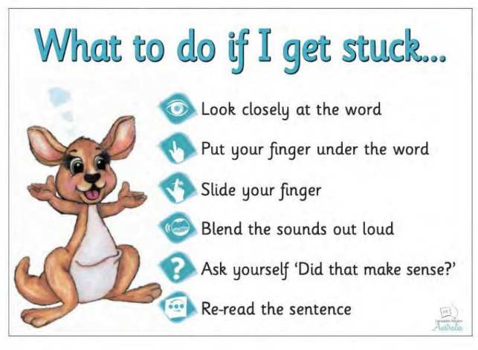
Notes:
In the past, when a student didn’t know a word, we got them to look at the first letter, skip it and read on, look at the picture and guess what the word might be. We don’t do that now. There’s no need to guess, because students can work out all the words.

Slide 21
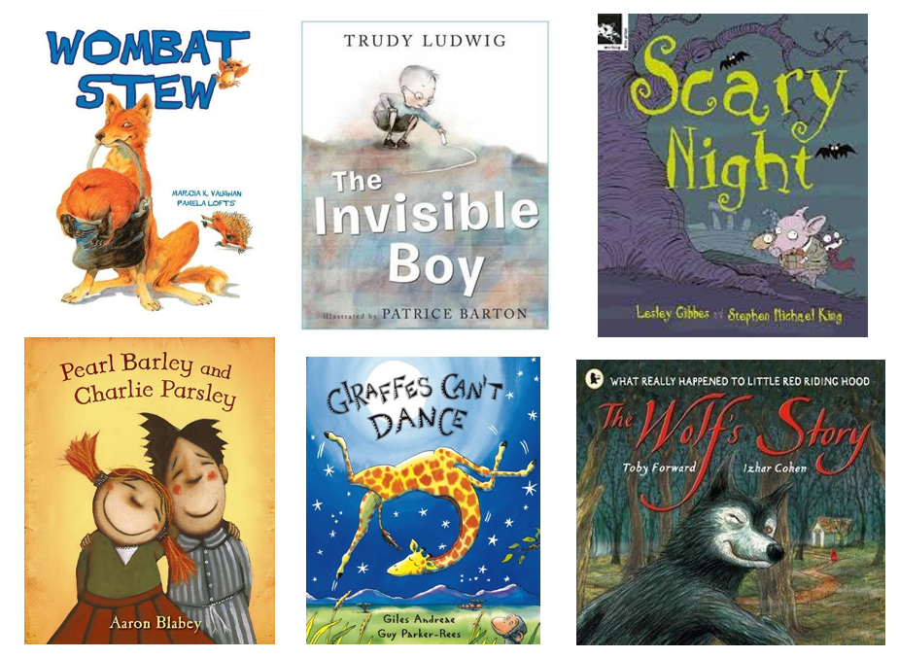
Quality texts
At RNPS, we still have a strong focus on developing student vocabulary, fluency and comprehension.
In K-6, we read quality story books for enjoyment, whilst focusing on building meaning through deep understanding.
We often link writing activities to quality texts.
Notes:
Read from slide
Oral language and vocabulary are SO important for helping students understand what they are reading. We dedicate an hour each day on a quality text where we focus on building vocabulary, comprehension & background knowledge.

Slide 22
Reading at Home
Students learning basic phonics will bring home decodable readers or have access to Decodable Readers Australia this term to practise sounds they are learning in class.
Students who have learnt basic phonics will bring home other books similar to previous years.
If you require a greater range of texts for your child, please let us know.
Notes:
-Hold up decodable texts

Slide 23
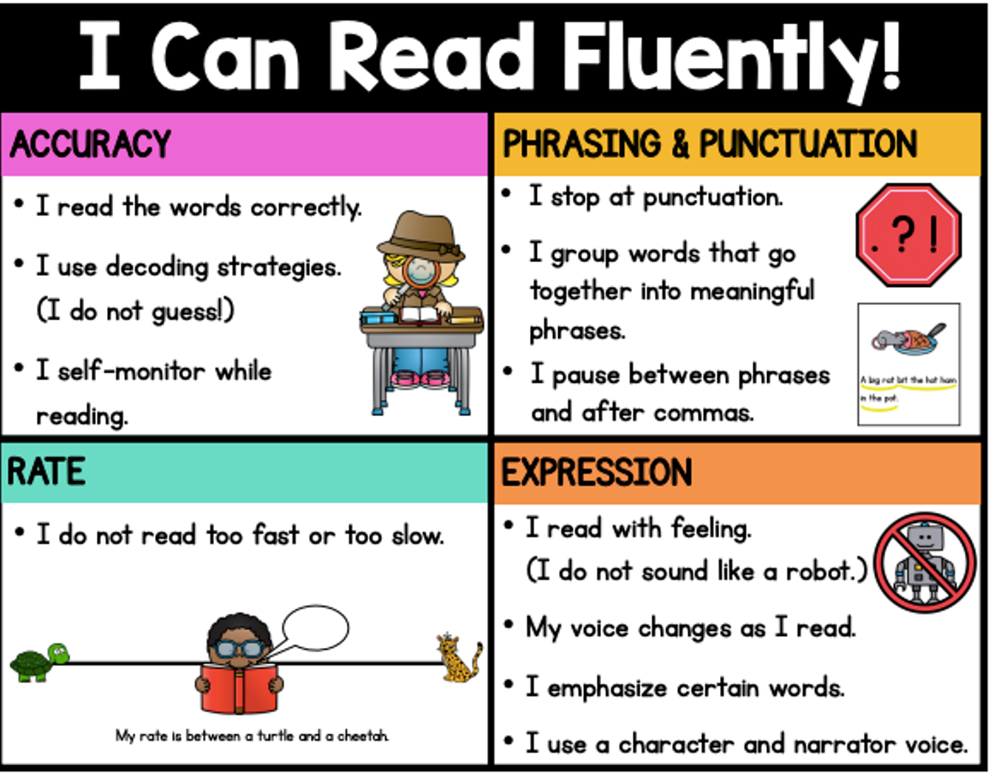
Fluency
We want your child’s reading to sound like they are talking.
Notes:
We still want students to read at home every day. 15- 20 minutes per day. Aloud to a parent is ideal in K-2. We have three posters to help you as you listen to them. 3-6 usually prefer to read silently to themselves.

Slide 24
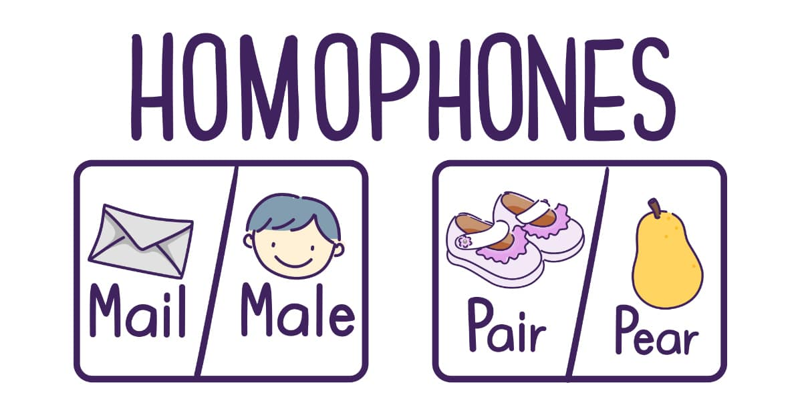
Homophones
Homophones are words that sound the same but have different spellings and meanings.

Slide 25
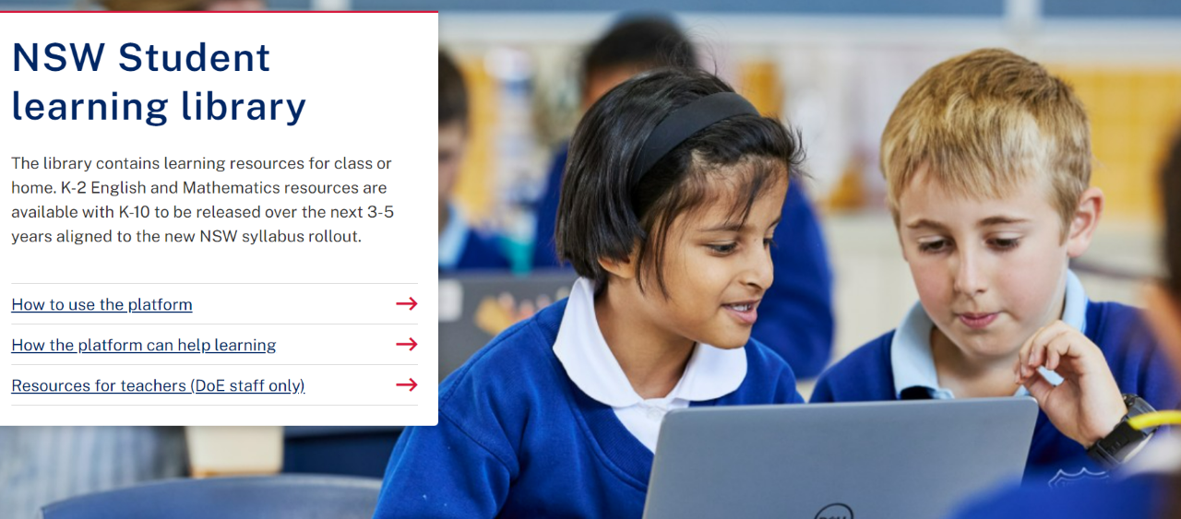
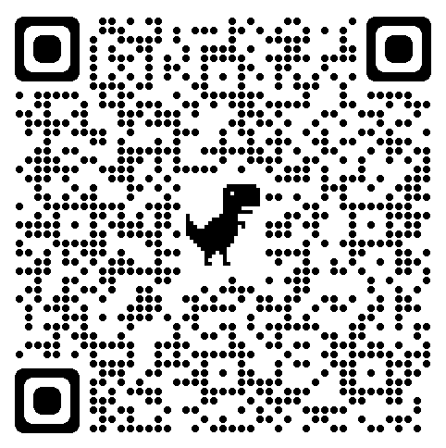
NSW student learning library
Notes:
-Online videos and activities for K-2 if you’re interested in doing some things at home.

Slide 26
Question Time
Thank you for attending today!

